Slide 1
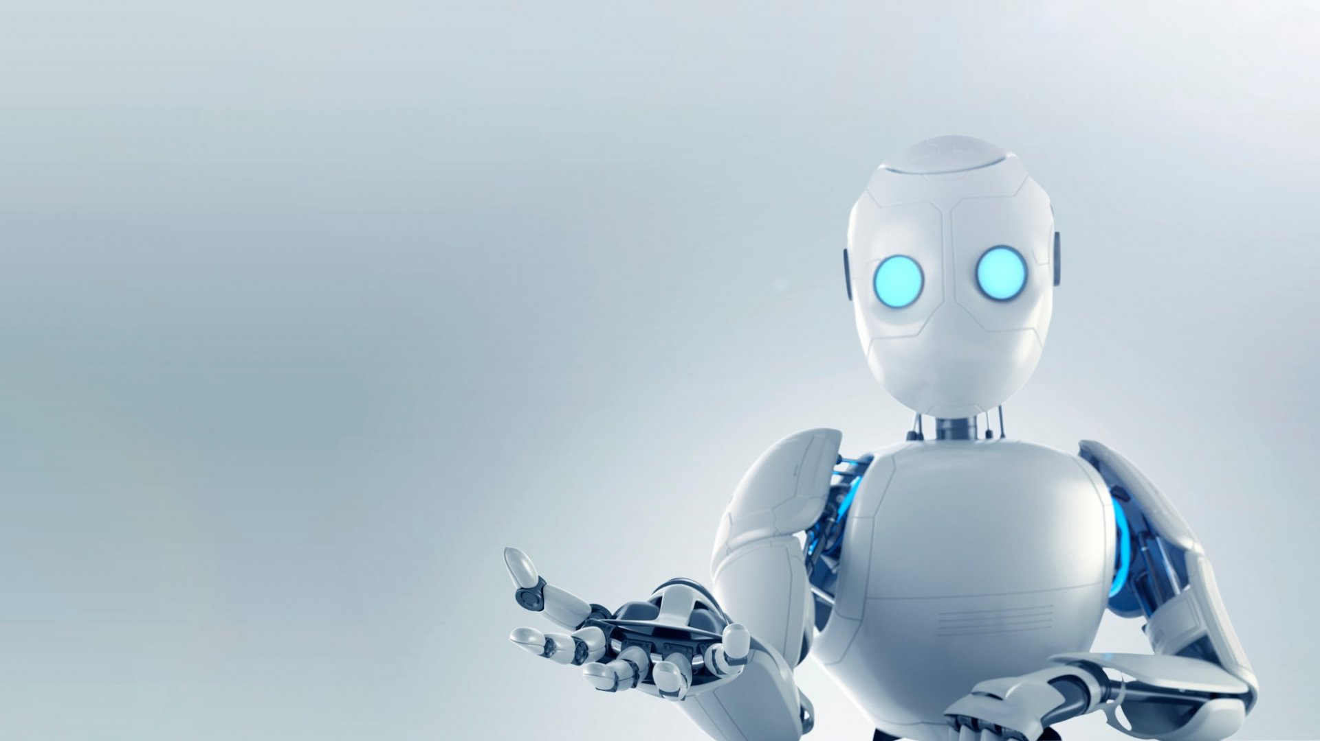
Price Negotiator Ecommerce Chatbot System

Slide 2

AGENDA
INTRODUCTION
TEAM
WHAT TO EXPECT
CONCLUSION
TECHNOLOGIES USED
PRELIMINARY SCOPE
CHATBOT ARCHITECTURE
USE CASES

Slide 3
INTRODUCTION
We know that negotiation is the process of exchange the highest likelihood of satisfying the needs of both parties.
The E- Negotiator Chabot helps the user to solve query and provide negotiation mode is dissatisfied with the price.
Such system will help the users to freely interact with the software and upload their product related queries and budget and get the response related to the query.
Price Negotiator E-Commerce Chatbot System introduced a system that makes the e-commerce sites to have their works in efficient manner. This project would help to automate
the online selling and negotiation based on price of product.

Slide 4
Team
Anish Arora
Sahil Grover
Sonal Raghuvanshi
Bhavna Panwar

Slide 5
Preliminary Scope
E-commerce websites has been developed and act as emerging technique in this current world. People made their purchasing after the introduction the e commerce websites in efficient manner. But while come in to an online purchasing the quality and price of the product is very important. Even though things we want are getting easier, still all people are very conscious in quality and rate of the particular product.
Having a best price which is not a fixed one will increase the payoff among sellers and buyers. Thus, an automated agent for negotiation has been designed in order to maintain a flexible and considerable price instead of fixed price.
Customer can buy products using a basket and negotiate the purchase. The bot should consider in the decision of discount the product or the basket value. Chat-bots are mainly used to provide conversation between both human and machine. Admin feed some knowledge to the machine so that machine can identify the sentences and taking a decision itself as response to answer a question.

Slide 6
What to Expect
In this project artificial intelligence and machine learning techniques will be applied innovatively to an ecommerce website introducing a new perspective to online shopping with artificial agents.
This project presents an aspect of negotiating and bargaining online and features a bargain-based e-commerce website, where chatbot act as a shopkeeper and can negotiate the price of the product with a customer and a content-based recommendation system that recommends similar products based on product attributes and description.
The chatbot is developed using deep learning algorithms combined with the natural language processing techniques and recommendation system is developed using natural language processing algorithms. This project is implemented using modern tools and technologies Python, Flask and Machine learning libraries Scikit-Learn and Keras.

Slide 7
ChatBot Architecture

Slide 8
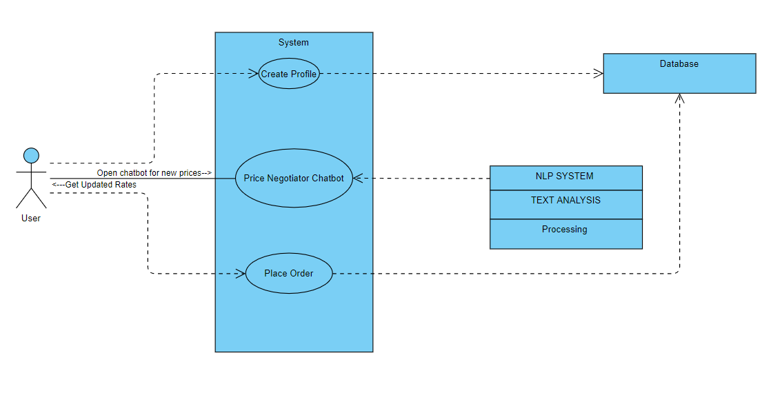
USE CASES performed by users

Slide 9
Technologies Used
The chatbot is developed using deep learning algorithms combined with the natural language processing techniques and recommendation system is developed using natural language processing algorithms. This project is implemented using modern tools and technologies Python, Flask and Machine learning libraries Scikit-Learn and Keras.

Slide 10


Conclusion
Chat Bots have indeed proven themselves as a powerful tool to customer satisfaction and an unmatched resource for the enterprises helping them save a lot of time and money. To date, different automated negotiation agents have been developed. Negotiation starts when supplier and customer have different expectations about price. Here we represent an E Negotiator chatbot for commercial websites which can help the users to get the product online according to their budget.

Slide 11

THANK YOU

